Slide 1
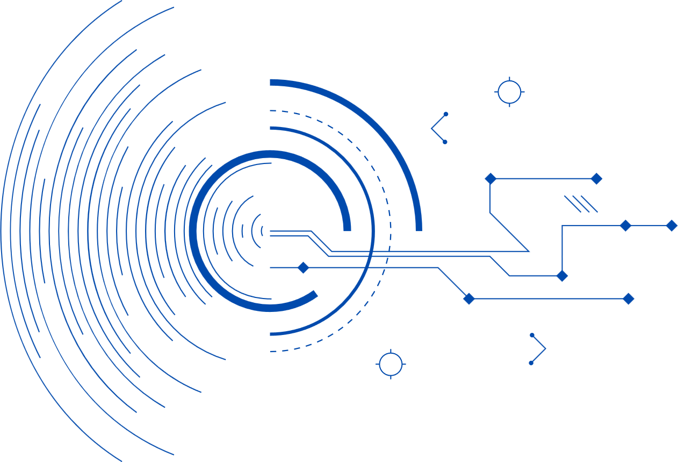




HACK WIFI
From Connection to Compromise:
The PMKID Attack
NATIONAL CYBERSECURITY
STUDENT ASSOCATION

Slide 2

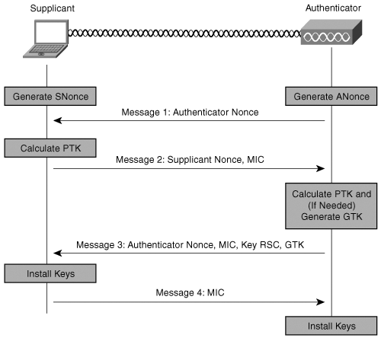

Four-Way Handshake
The four-way handshake is a security protocol used in WPA/WPA2 WiFi networks to validate that both the client and the Access Point (AP) each have the proper credentials.
During the handshake, unique encryption keys are derived and exchanged, ensuring secure communication between the client and the AP.
To exploit the handshake, one only needs to capture the PMKID (from the first handshake message) and does not require a client to be actively connecting.
Once the PMKID is captured, it can be used offline to derive the PMK (and thus the PSK) by brute-forcing its values against the known PMKID.

Slide 3


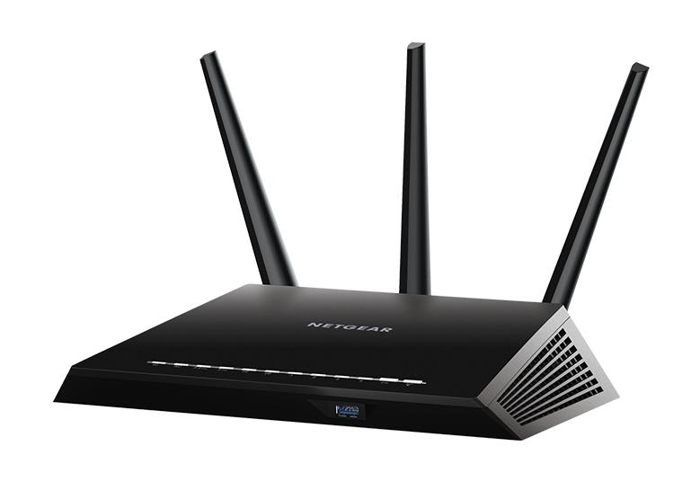
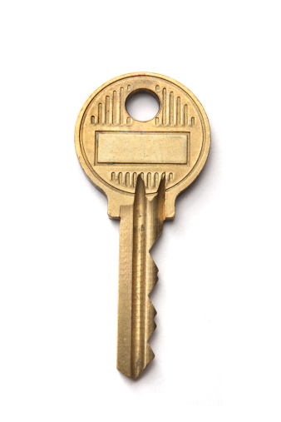
Four-way handshake
Client (PC)
Access point (Router)
Authentication request frame
Authentication response frame
Association request frame
Association response frame
PMK
PMK

Slide 4


Four-way handshake
Cached PMKID

Slide 5
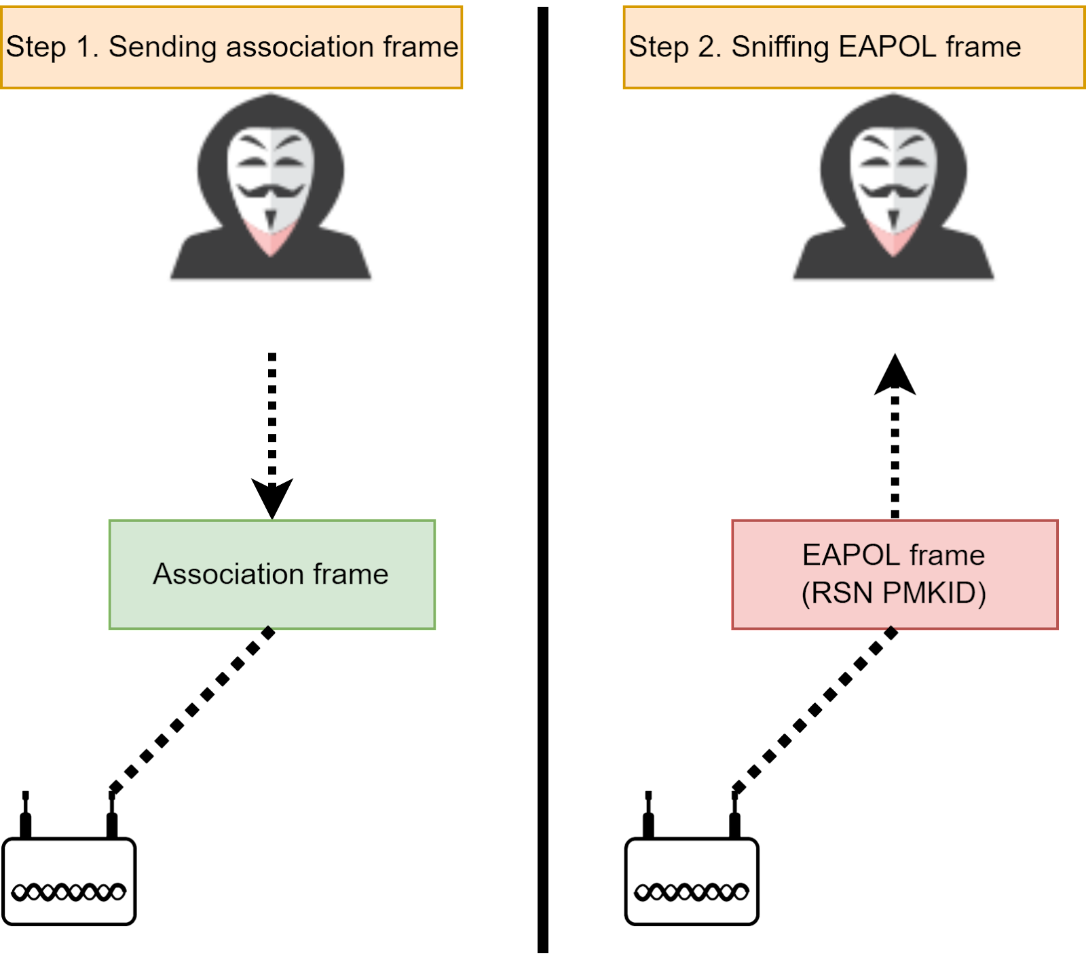

Slide 6

PMKID Attack Path
1
Probe for Networks
2
Observe AP Broadcasting the PMKID
3
Capture the PMKID
4
Crack the PMKID!

Slide 7
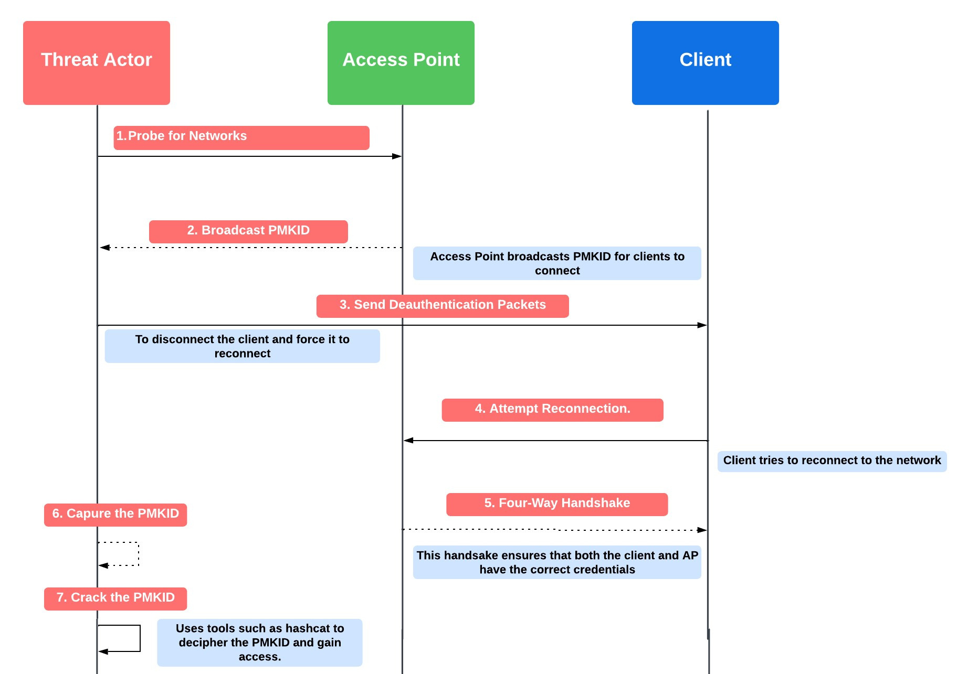

Slide 8
Q & A

